Slide 1
UNIT IV

Slide 2
PROJECT IDENTIFICATION
Project identification starts with generation of a product idea.
In order to select a most promising project, the entrepreneur needs to generate few ideas about the possible projects he/she can undertake.

Slide 3
Internal and External sources of project ideas
  Knowledge of potential customer needs
  Watching emerging trends of demand
  Scope for producing substitute product
  Going through professional magazines
  Success stories of entrepreneurs
  Visits to trade fairs, exhibitions
  Meeting government agencies
  Ideas given by experts
  Knowledge on government policies, concessions, incentives
  New product introduced by competitor

Slide 4
Project identification
All the sources put together may give ideas about the possible project to be examined as the final project –which is described as ‘Opportunity scanning and identification’.

Slide 5
Criteria for identifying a project
  Investment size
  Location
  Technology
  Equipment
  Marketing

Slide 6
Importance of project identification
  Catalyst agents of economic development
  Initiate development – Employment and income generation
  Long term benefits
  Framework for future activities of enterprise
  Involve Financial outlays
  Initiate development of basic infrastructure and environment
  Brings necessary changes in society
  Accelerate process of socio-cultural development

Slide 7
PROJECT SELECTION
Project selection starts where project identification ends.
The intending entrepreneur analyses his/her strengths and weaknesses as well as opportunities/competitive advantages and threats/challenges offered by each of the project ideas(SWOT analysis).
On the basis of analysis, the most suitable idea is selected and converted into an enterprise.
The process of selecting a project out of few projects is described as “zeroing in process”.

Slide 8
PROJECT SELECTION
Entrepreneur needs to analyze other related aspects like raw material, market, labour, capital, location, forms of ownership etc.
Each of these aspects have to be analysed independently to check their interdependence.

Slide 9
Factors affecting Project Selection
Product
Raw material
Working
capital
Location
Ownership
Total investment
Labour
Market

Slide 10
PROJECT FORMULATION
Project formulation is defined as “taking a first look carefully and critically at a project idea by an entrepreneur to assess the benefits of the project after carefully weighing its various components”.

Slide 11
Aims of Project formulation
Carefully identify and weight various components of project work
Analyze project feasibility and cost-effectiveness
Examine and approve project inputs and outputs
Identify stakeholders and their involvement and contribution
Define benefits and expectations
Estimate resources needed
Perform a preliminary analysis of risks
Make an outline of project schedule

Slide 12
Need for project formulation
Selection of appropriate technology
Influence of external economies
Resource mobilization
Knowledge about government regulations
Lack of technically qualified personnel

Slide 13
Significance of project formulation
Project report is like a roadmap
  Identifies goals
  Enables entrepreneur to move in right direction
Attracts lenders and investors
  Helps in applying for financial institution
  Quality of firm’s report weighs in decision to lend or invest funds

Slide 14
Formulation of a project report
Project report is a written statement of what an entrepreneur proposes to take up.

Slide 15
CONTENTS OF A GOOD PROJECT REPORT
General information
Promoter
Location
Land and building
Plant and machinery
Production process
Utilities
Transport and communication
Raw material
Manpower
Product
Market
Requirement of working capital
Cost of production and profitability
Break even analysis
Schedule of implementation

Slide 16
STAGES OF PROJECT FORMULATION
1) General information
  Bio-data of promoter
  Industry profile
  Constitution and organization
  Product details

Slide 17
2) Project description
  Site
  Physical infrastructure
  Utilities
  Pollution control
  Communication system
  Transport facilities
  Other common facilities
  Production process
  Machinery and equipment
  Capacity of the plant
  Technology selected
  Research and Development

Slide 18
3) Market potential
  Marketing strategy
  After-sales service
  Transportation
  4) Capital costs and sources of finance
  Estimate of capital items
  Owner’s funds
  Funds from banks, financial institutions
6) Assessment of working capital requirements

Slide 19
7) Other financial aspects
  Profit and loss account
  Balance sheet
  Break-even analysis
  Cash flow statement
  F
  S-V
  F = Fixed cost
  S = Sales projected
  V = Variable costs
BEP =
x 100

Slide 20
7) Economic and social variables
  Employment generation
  Import substitution
  Ancillarisation
  Exports
  Local resource utilization
  Development of the area
  8) Project Implementation
    Time -table

Slide 21
Implementation schedule
Tasks \ Months | 1 | 2 | 3 | 4 | 5 | 6 | 7 | 8 | 9
1. Formulation of project report
2. Application of term loan
3. Sanction of loan
4. Possession of land
5. Construction of building
6. Power and water
7. Placing order for machinery
8. Manpower recruitment
9. Trial production
10. Commencement of commercial production

Slide 22
PLANNING COMMISION GUIDELINES FOR FORMULATING A PROJECT REPORT
General information
Preliminary evaluation of alternatives
Project description
Marketing plan
Capital requirements and costs
Operating requirements and costs
Financial analysis
Economic analysis
Miscellaneous aspects

Slide 23
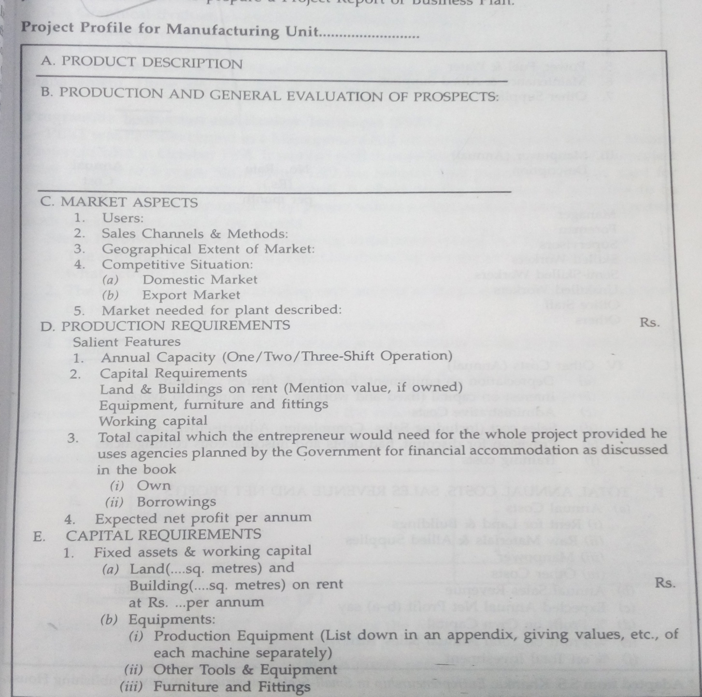
SPECIMEN OF A PROJECT REPORT

Slide 24
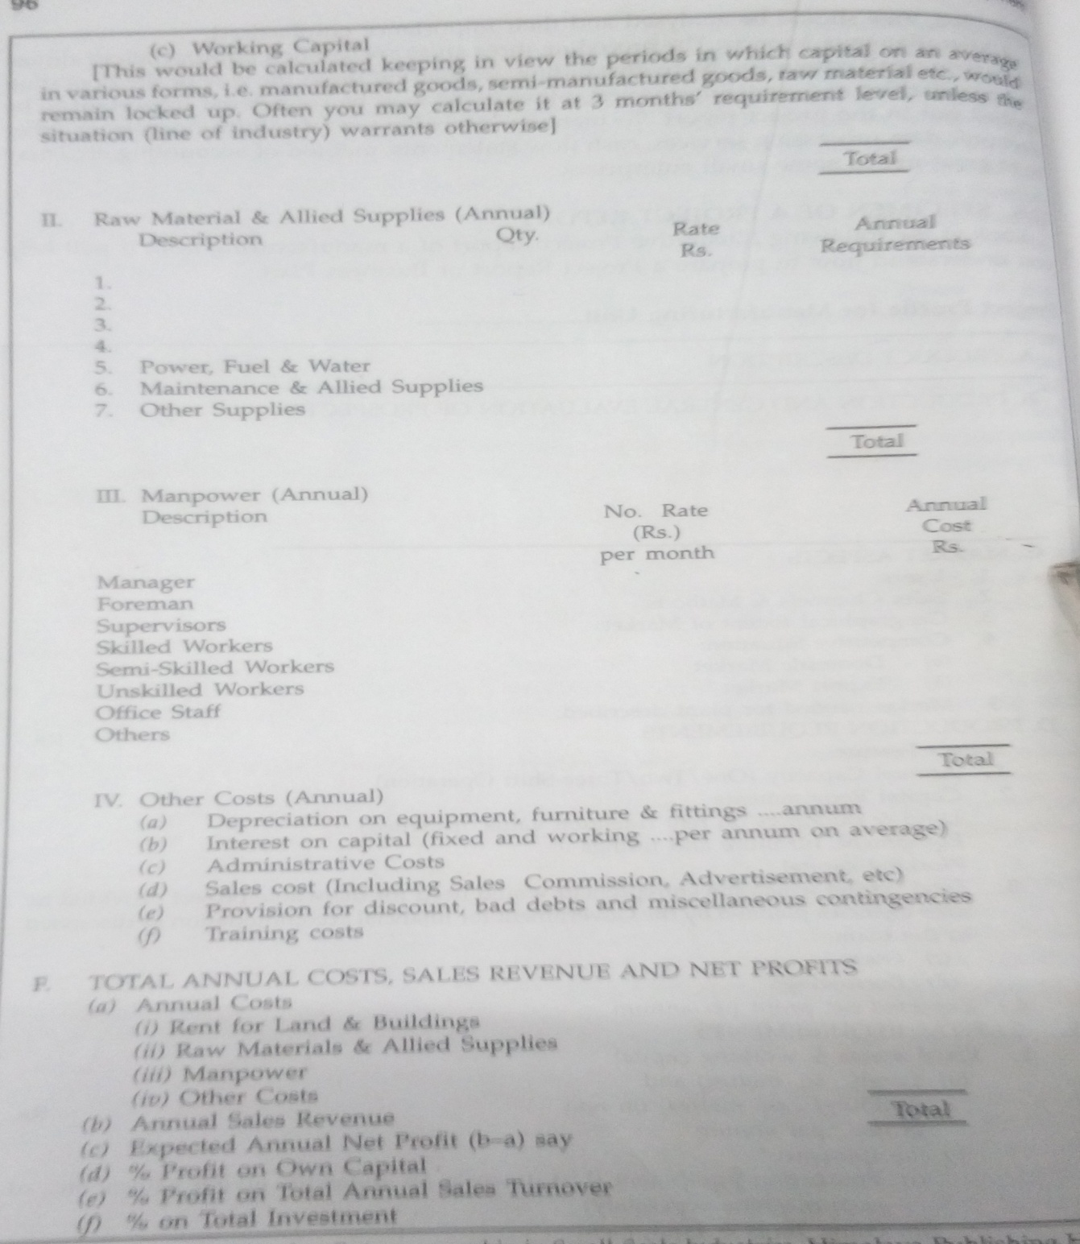

Slide 25
Network Analysis
A network is a set of symbols connected with each other with a sequential relationship with each step making the completion of a project/event.
There is a need for deciding the sequential order of activities in order to complete the project/event in minimal time with limited resources called project scheduling.
Programme Evaluation and review Technique(PERT)
Critical Path Method(CPM)
Graphical Evaluation and Review Technique(GERT)
Workshop Analysis Scheduling Programme(WASP)
Line of balance(LOB)

Slide 26
Common errors in project formulation
Product selection
Capacity utilization estimates
Market study
Technology selection
Location selection
Selection of ownership form

